Slide 1


`
The Quest for Fair Funding

Slide 2
EPS was spending less than 90% of PA school districts on a per pupil basis
Budget increase needed to spend at county average - $10.3 million
Budget increase needed to spend at state average - $40.6 million

Slide 3
Despite budget cuts, Erie still faced multi-million budget deficits

Slide 4
Raising real estate taxes was not a viable solution
 | % | Amount
Worst case tax increase needed to balance 16-17 budget | 14.9% | $5,760,000
Tax increase allowed | 3.7% | $1,428,200

Slide 5
Best option available – A permanent increase in Basic Education Subsidy
Legislature has made “one-off” Basic Ed. Adjustments
  2013-14 English language learner high incident supplement
  All districts with a 2012-13 ADM greater than 18,500, a MV/PI AR greater than 0.7000, and an English language learner concentration greater than or equal to 10.8% received $8,000,000.

Slide 6
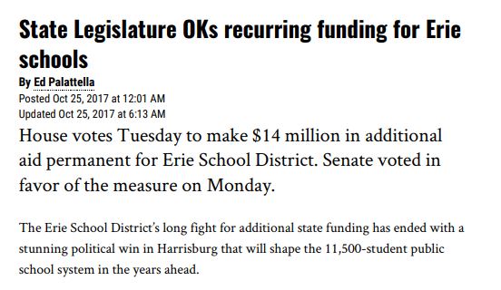
October 24, 2017
Legislature makes $14 million permanent!
Erie placed in Financial Watch (695-A)

Slide 7
EPS Comparison After $14 Million Adjustment
DATA POINT | RANK
Median Household Income - $35,802 | 484th (bottom 3%)
Economically Disadvantaged – 80.1% | 12th (top 3%)
English Language Learners– 9.2% | 13th (top 3%)
Charter Enrollment – 17.6% | 11th ( top 3%)
State & Local Revenue per Pupil (ADM) – $14,990 | 420th (bottom 20%) 488th (bottom 3%) prior to $14M
Total Revenue per Pupil (ADM) – $16,193 | 367th (bottom 30%) 466th (bottom 7%) prior to $14M

Slide 8

After $14 Million State Funding Adjustment

Slide 9
A decade of financial distress
Five buildings closed
More than 260 full-time positions eliminated
Central administration cut in half
Numerous program cuts
Employees had little to no wage increases
Schools desperately needed millions of dollars in deferred maintenance

Slide 10
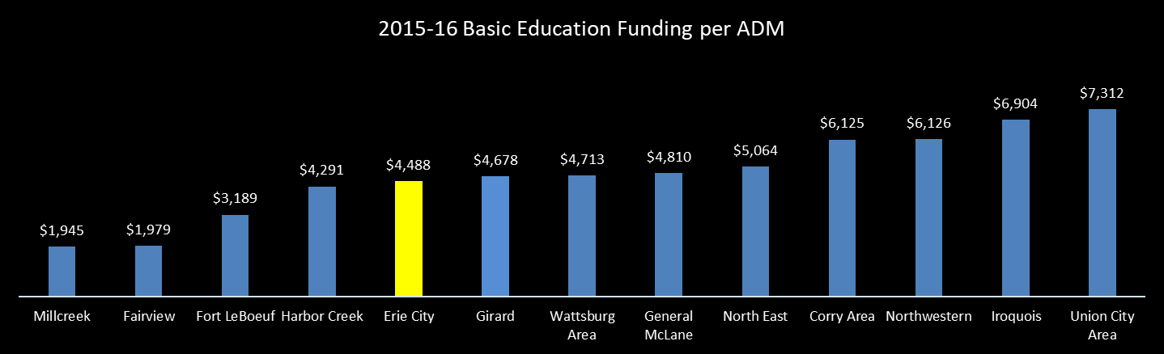
EPS’s 2013-14 state and local revenue per pupil (ADM) is the lowest in IU #5
School District | 2013-14 State & Local Revenue per Pupil (ADM) | Fast Facts
 |  | 2014-15 Median Household Income | 2014-15 Economically Disadvantaged | 2014-15 Special Education | 2014-15 English Language Learner | 2014-15 Charter | 2013-14 Average Daily Membership
Conneaut | $15,044 | $44,652 | 51.1% | 16.4% | 0.1% | 6.0% | 2,293.32
Wattsburg Area | $14,718 | $62,979 | 32.5% | 20.8% | 0.1% | 3.0% | 1,441.27
Harbor Creek | $14,353 | $62,236 | 32.7% | 14.5% | 0.1% | 2.0% | 2,063.98
Fairview | $14,311 | $76,602 | 18.9% | 10.0% | 0.7% | 0.7% | 1,581.95
Iroquois | $14,263 | $52,317 | 60.8% | 17.7% | 0.4% | 2.4% | 1,220.26
PENNCREST | $14,132 | $46,695 | 39.1% | 16.4% | 0.3% | 3.6% | 3,257.28
Warren County | $13,764 | $44,426 | 47.5% | 17.4% | 0.1% | 7.4% | 4,855.85
General McLane | $13,527 | $52,188 | 33.6% | 14.5% | 0.3% | 1.9% | 2,189.29
Corry Area | $13,478 | $39,252 | 61.5% | 21.7% | 0.1% | 2.1% | 2,146.12
Crawford Central | $13,284 | $43,371 | 51.8% | 16.8% | 0.2% | 3.0% | 3,953.76
Fort LeBoeuf | $13,085 | $54,426 | 47.0% | 16.0% | 0.6% | 1.6% | 2,149.55
North East | $12,728 | $49,462 | 50.2% | 11.1% | 0.1% | 2.0% | 1,699.87
Union City Area | $12,648 | $45,257 | 59.1% | 13.6% | 0.0% | 2.4% | 1,283.32
Northwestern | $12,421 | $50,336 | 14.7% | 14.8% | 0.2% | 2.5% | 1,509.21
Millcreek | $12,012 | $55,547 | 38.1% | 13.6% | 1.2% | 1.8% | 7,211.88
Girard | $11,848 | $49,073 | 52.5% | 16.1% | 0.2% | 3.4% | 1,865.61
Erie City | $11,143 | $33,049 | 80.1% | 16.9% | 9.2% | 14.4% | 13,576.84
AVERAGE | $13,339 | $50,696 | 45.4% | 15.8% | 0.8% | 3.5% | 3,194.08
To meet the IU #5 per pupil average, annual revenues at EPS must increase by $29,814,741
To meet Union City’s per pupil Basic. Ed. funding, EPS’s revenues would need to increase $50,223,091 annually
PSSA Percent Proficient/Advanced (3 year average)
District | Erie | Union City
Math | 18% | 43%
ELA | 32% | 57%

Slide 11
EPS’s 2013-14 state and local revenue per pupil (ADM) is the lowest in IU #5
To meet Pittsburgh’s per pupil funding, EPS’s revenues would need to increase $17,769,982 annually
School District | 2013-14 State & Local Revenue per Pupil (ADM) | Fast Facts
 |  | 2014-15 Median Household Income | 2014-15 Economically Disadvantaged | 2014-15 Special Education | 2014-15 English Language Learner | 2014-15 Charter | 2013-14 Average Daily Membership
Conneaut | $15,044 | $44,652 | 51.1% | 16.4% | 0.1% | 6.0% | 2,293.32
Wattsburg Area | $14,718 | $62,979 | 32.5% | 20.8% | 0.1% | 3.0% | 1,441.27
Harbor Creek | $14,353 | $62,236 | 32.7% | 14.5% | 0.1% | 2.0% | 2,063.98
Fairview | $14,311 | $76,602 | 18.9% | 10.0% | 0.7% | 0.7% | 1,581.95
Iroquois | $14,263 | $52,317 | 60.8% | 17.7% | 0.4% | 2.4% | 1,220.26
PENNCREST | $14,132 | $46,695 | 39.1% | 16.4% | 0.3% | 3.6% | 3,257.28
Warren County | $13,764 | $44,426 | 47.5% | 17.4% | 0.1% | 7.4% | 4,855.85
General McLane | $13,527 | $52,188 | 33.6% | 14.5% | 0.3% | 1.9% | 2,189.29
Corry Area | $13,478 | $39,252 | 61.5% | 21.7% | 0.1% | 2.1% | 2,146.12
Crawford Central | $13,284 | $43,371 | 51.8% | 16.8% | 0.2% | 3.0% | 3,953.76
Fort LeBoeuf | $13,085 | $54,426 | 47.0% | 16.0% | 0.6% | 1.6% | 2,149.55
North East | $12,728 | $49,462 | 50.2% | 11.1% | 0.1% | 2.0% | 1,699.87
Union City Area | $12,648 | $45,257 | 59.1% | 13.6% | 0.0% | 2.4% | 1,283.32
Northwestern | $12,421 | $50,336 | 14.7% | 14.8% | 0.2% | 2.5% | 1,509.21
Millcreek | $12,012 | $55,547 | 38.1% | 13.6% | 1.2% | 1.8% | 7,211.88
Girard | $11,848 | $49,073 | 52.5% | 16.1% | 0.2% | 3.4% | 1,865.61
Erie City | $11,143 | $33,049 | 80.1% | 16.9% | 9.2% | 14.4% | 13,576.84
AVERAGE | $13,339 | $50,696 | 45.4% | 15.8% | 0.8% | 3.5% | 3,194.08
To meet the IU #5 per pupil average, annual revenues at EPS must increase by $29,814,741

Slide 12
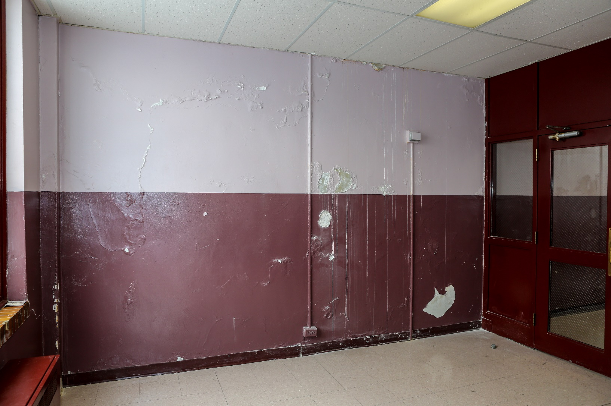
Lincoln Elementary hallway

Slide 13
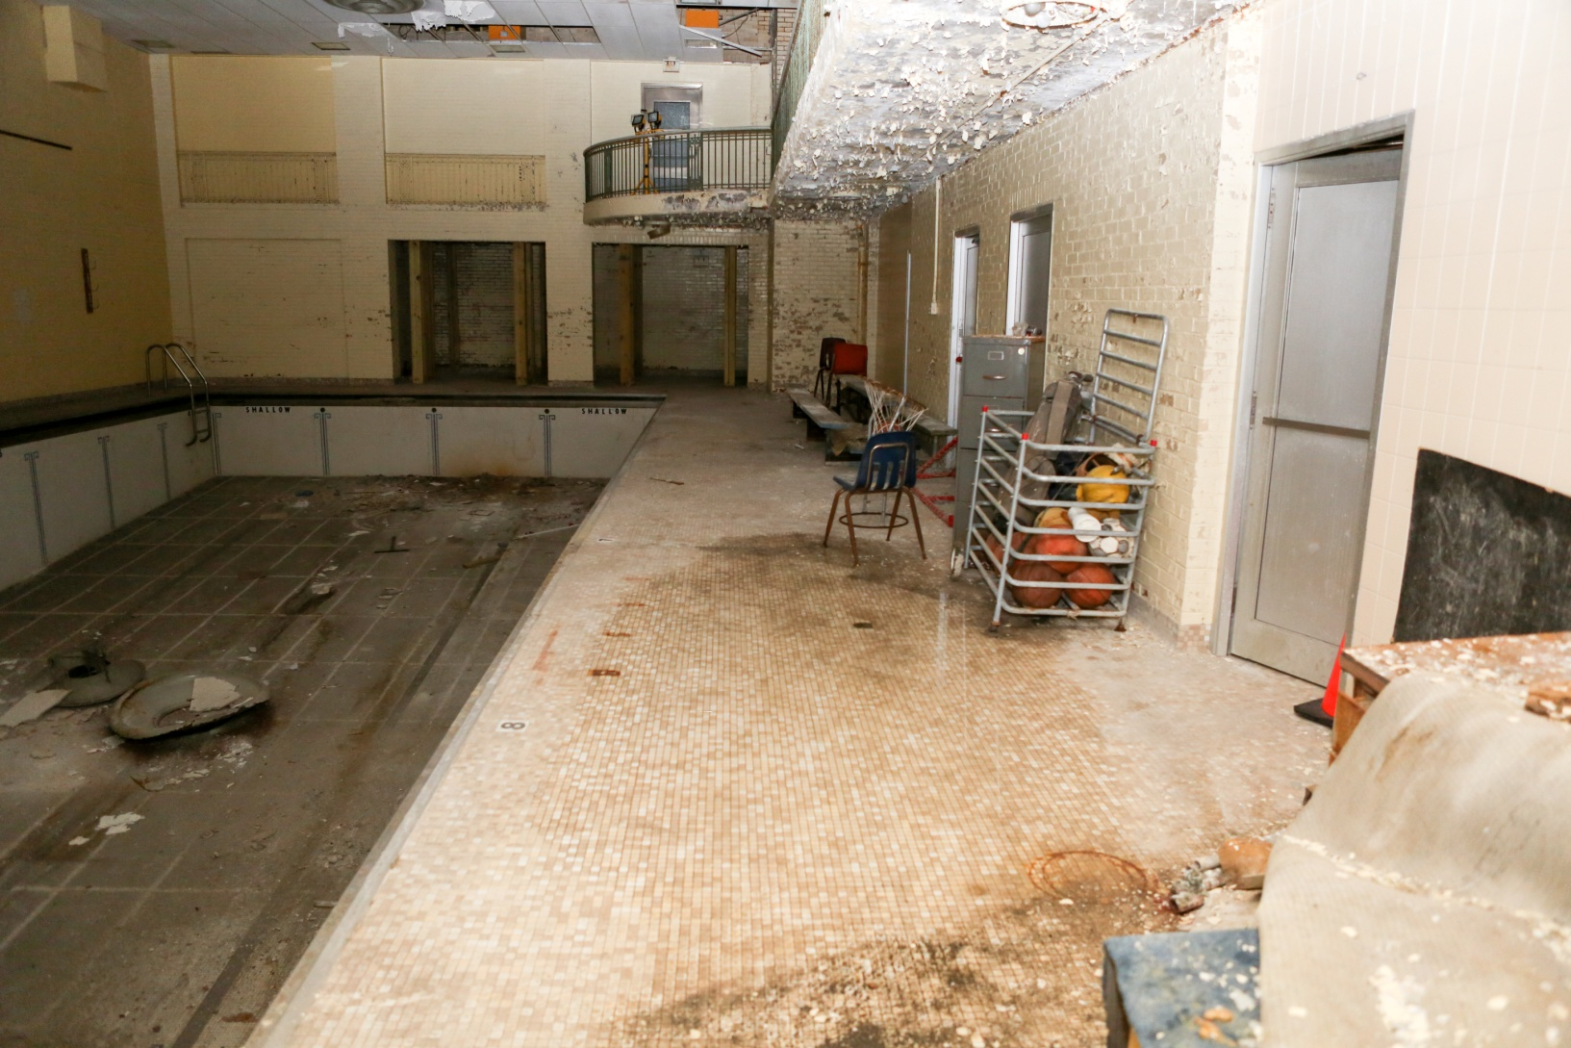
Collegiate Academy pool space

Slide 14
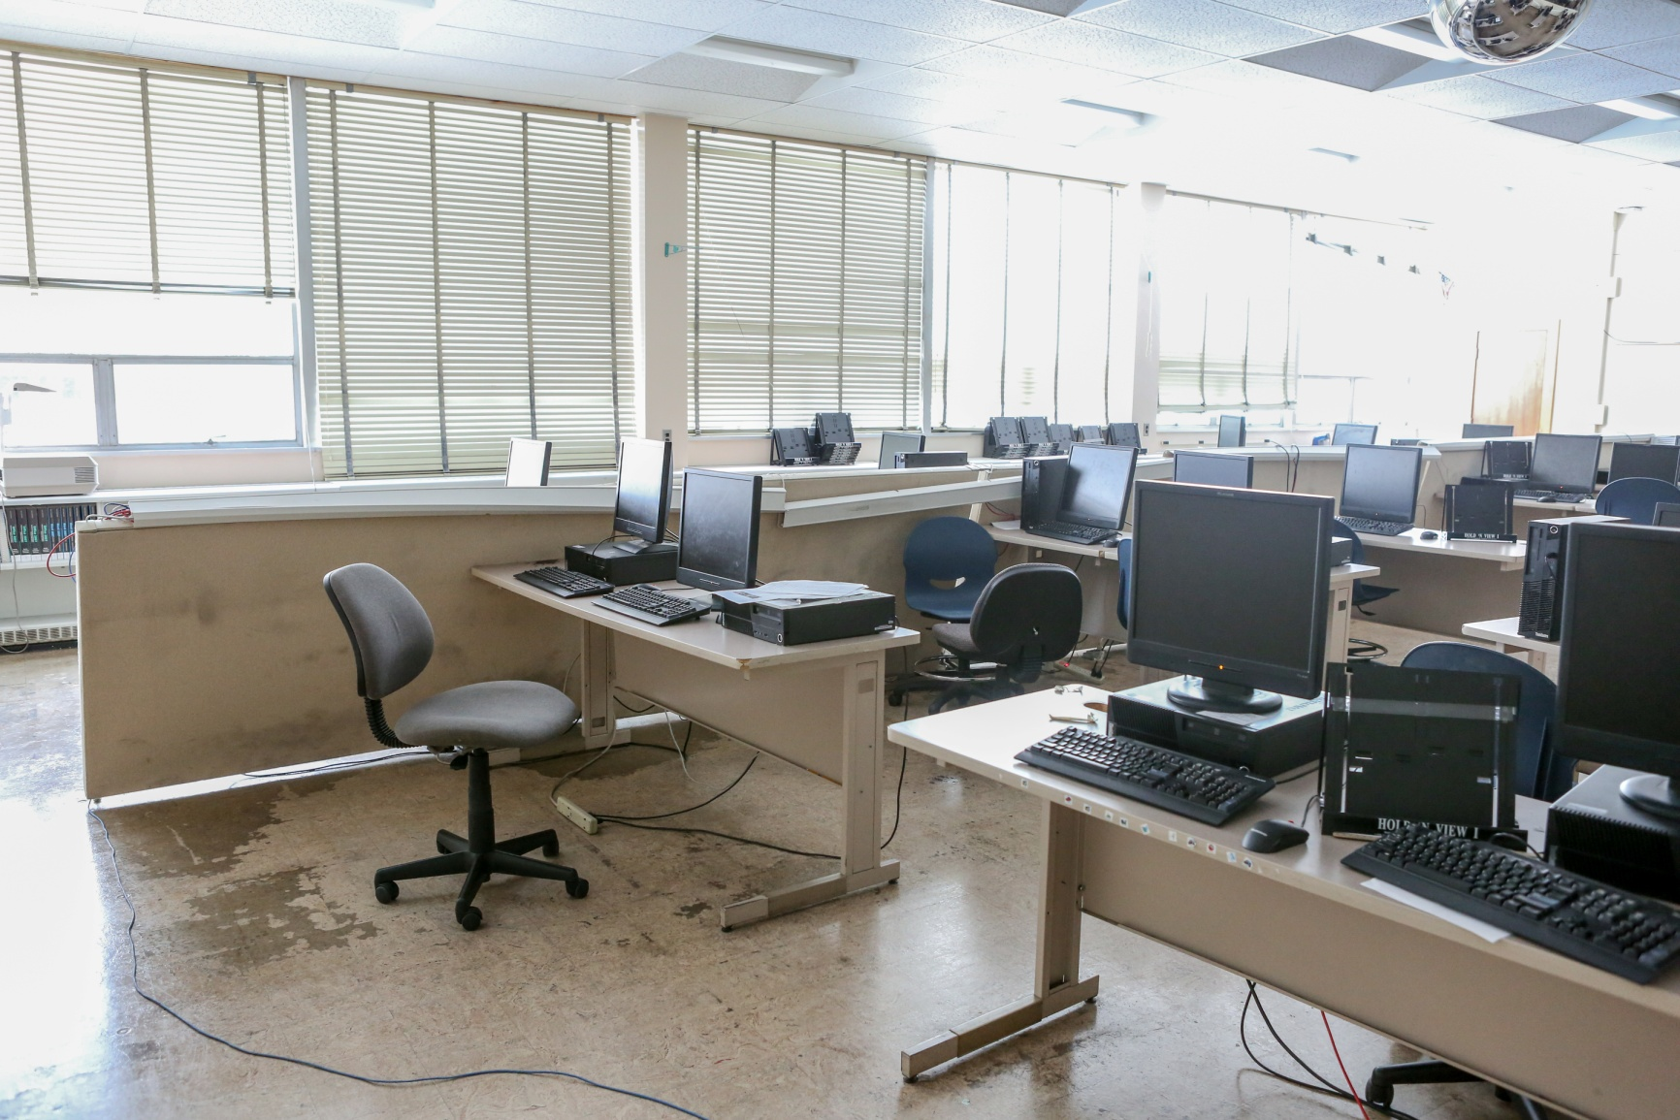
Erie School District
Central Tech accounting class

Slide 15
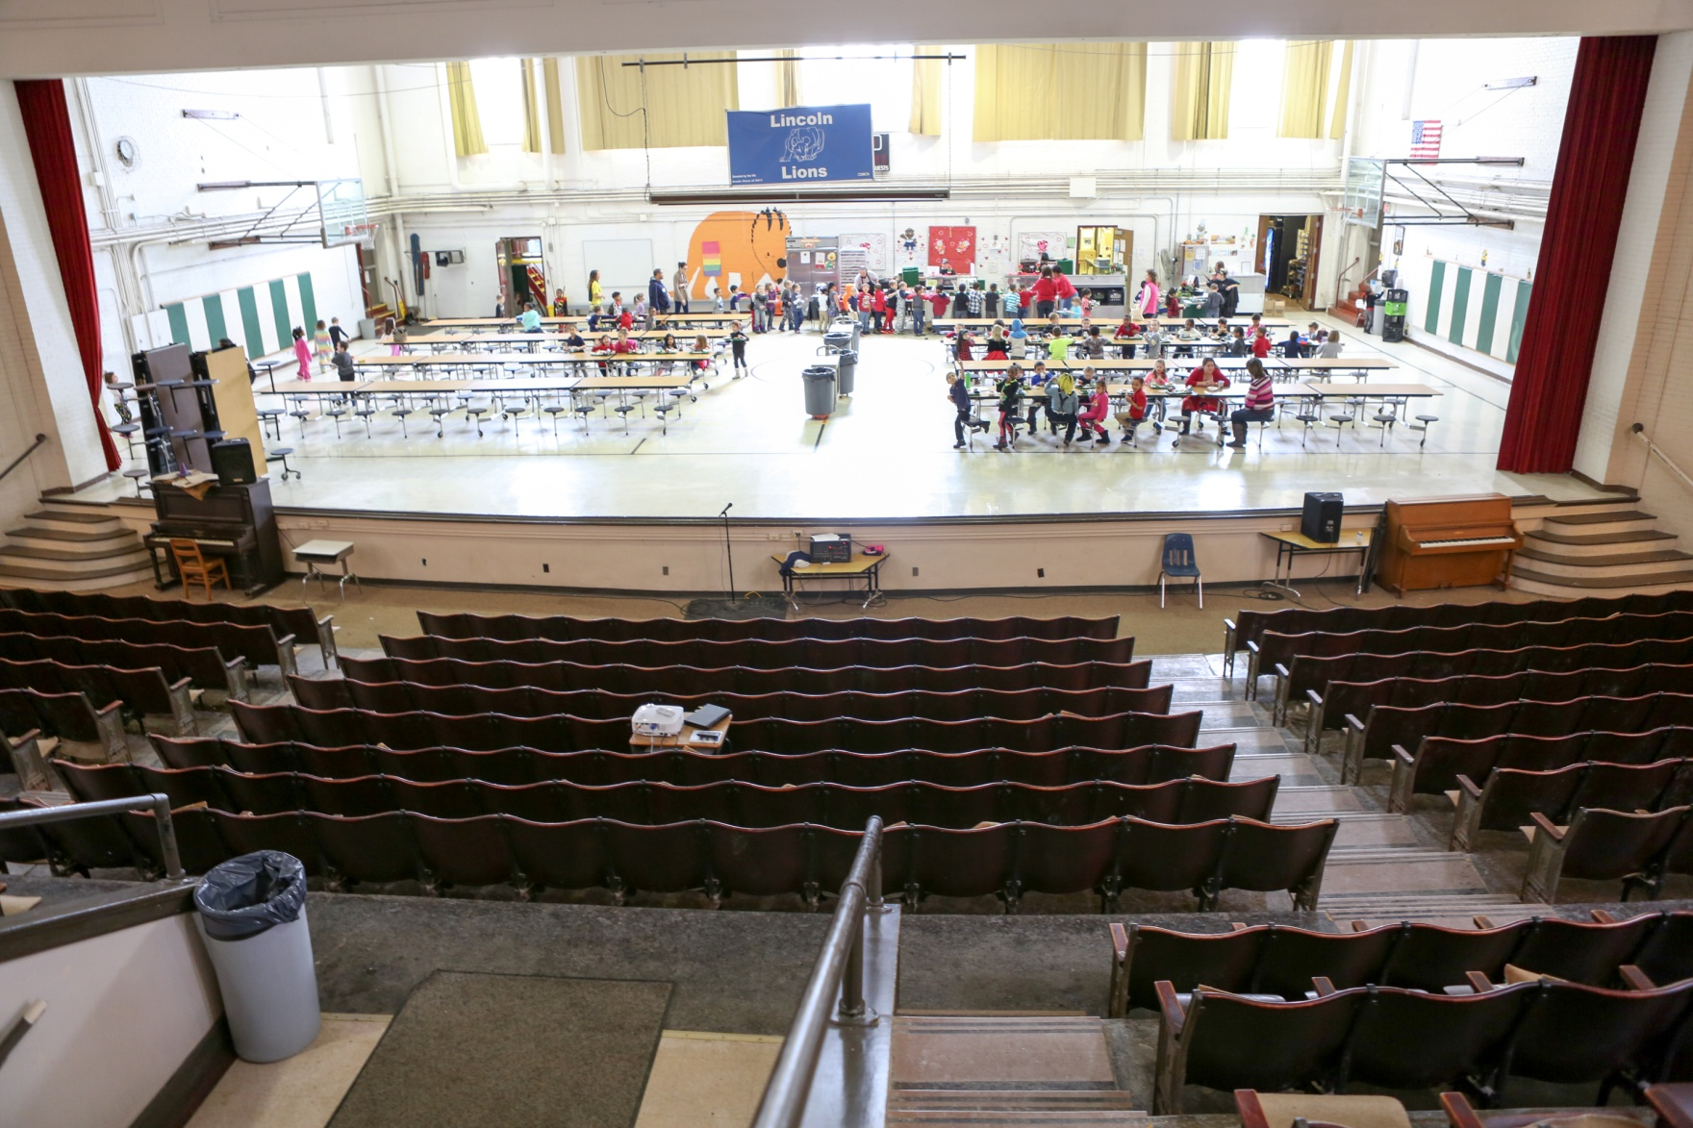
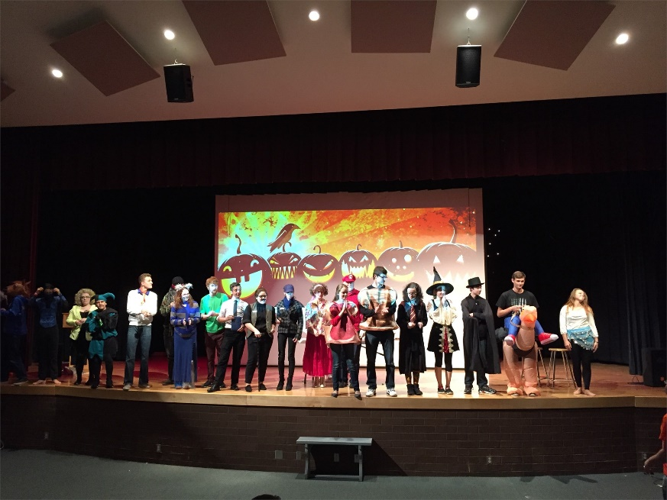
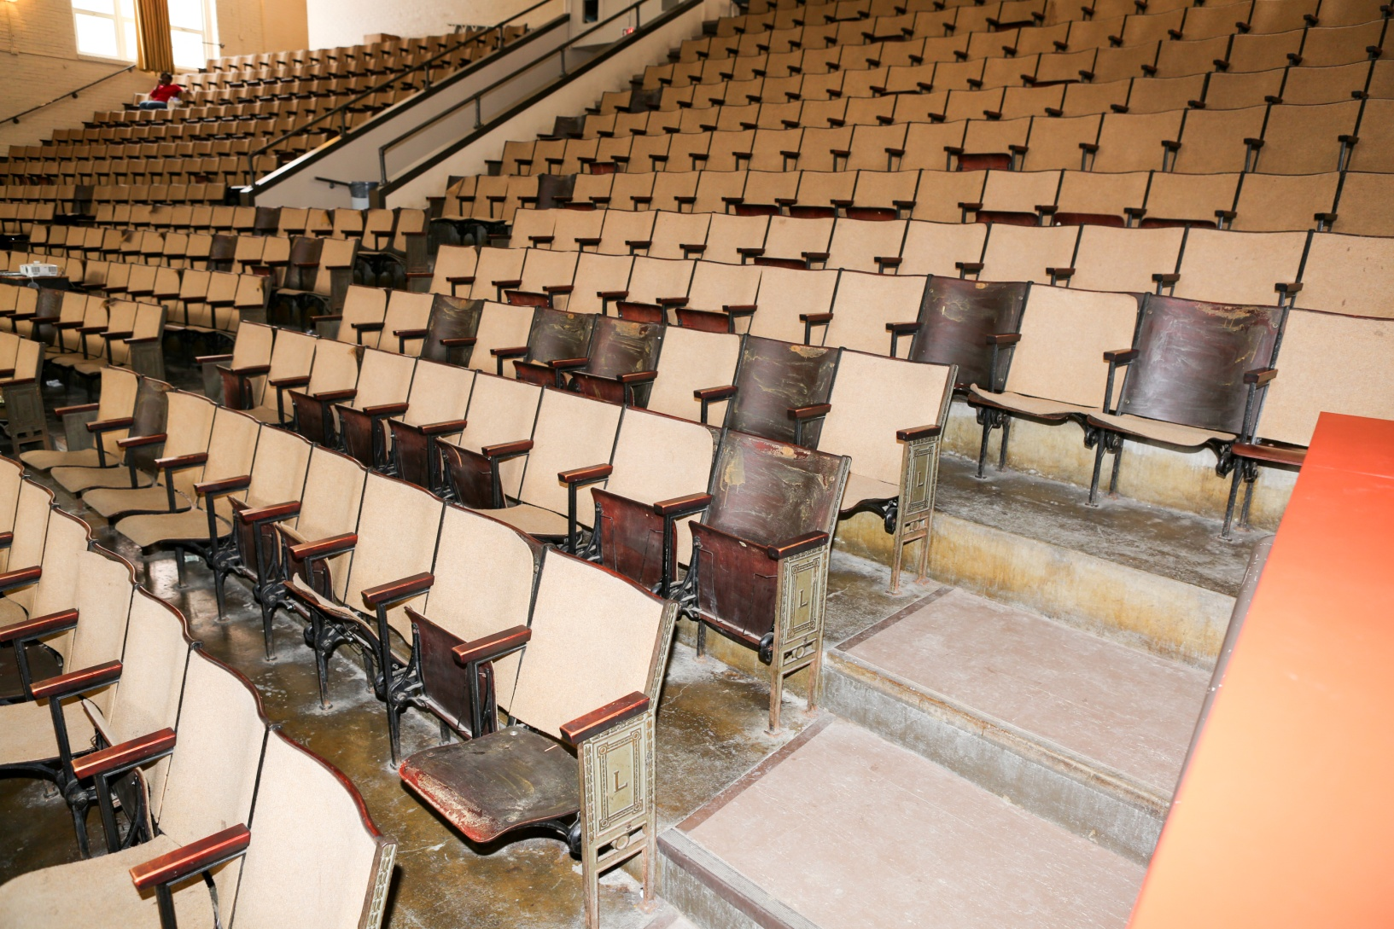
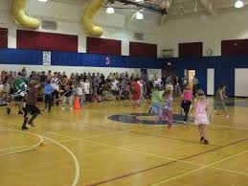
Erie School District
Lincoln Elementary auditorium/cafeteria/gym
Wattsburg School District
Wattsburg Elementary
auditorium & gym (separate cafeteria not pictured)

Slide 16
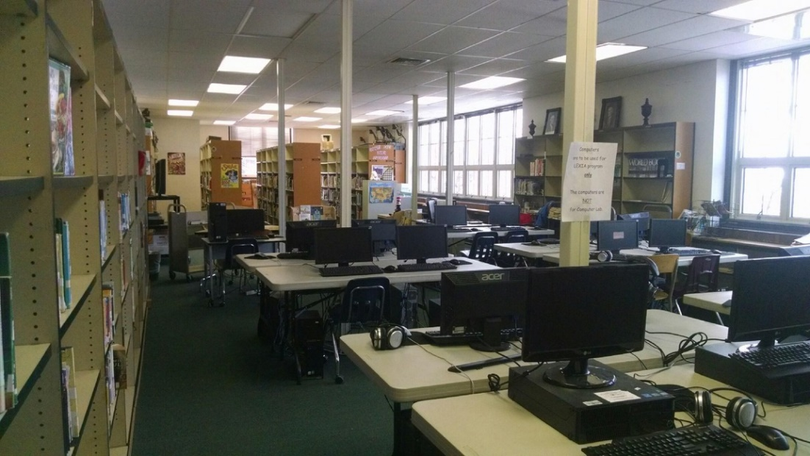
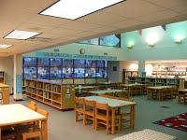
Erie School District
Lincoln Elementary library
Girard School District
Elk Valley Elementary library
Book & Supply Budget
Erie SD (18 libraries) $18,000
North East SD (3 libraries) $40,910

Slide 17
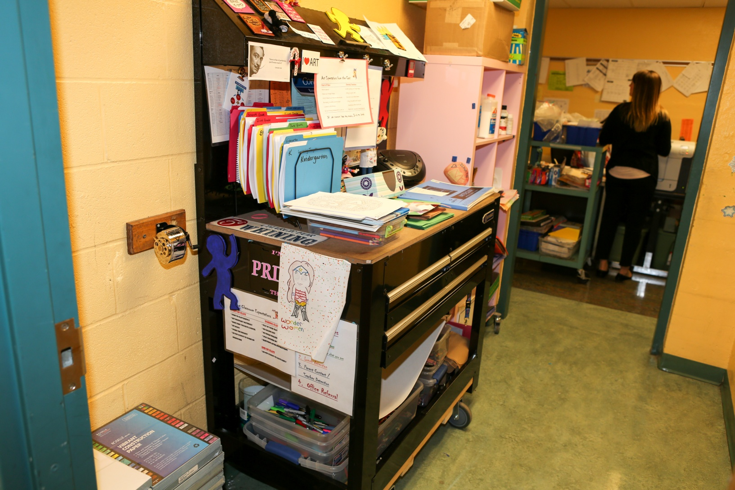
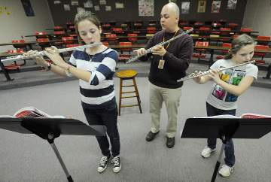
Erie School District
Diehl Elementary
“art-on-a-cart”
Harbor Creek School District
Clark Elementary
music room

Slide 18
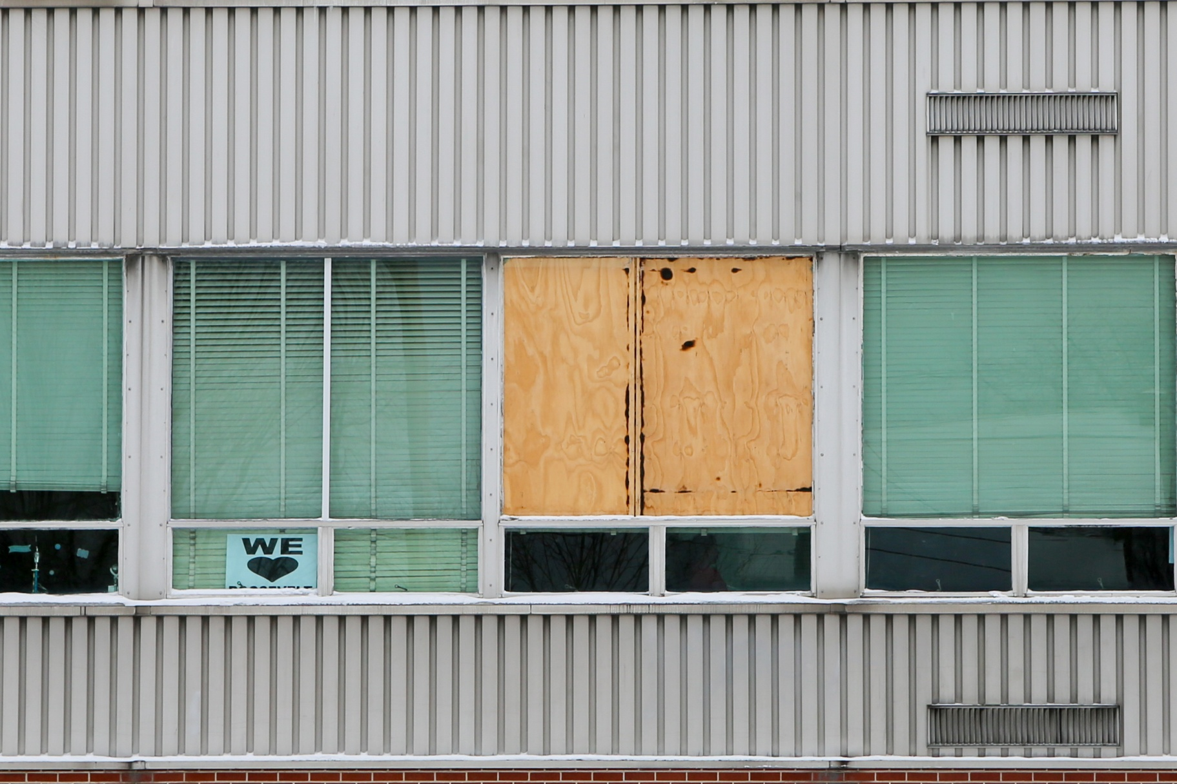
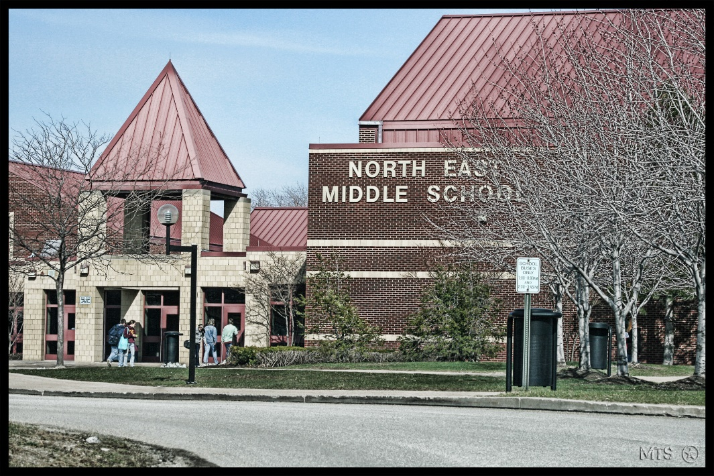
Erie School District
Roosevelt M.S. Exterior
North East School District
North East M.S. Exterior

