Slide 1
Understanding the Connection Between Investments in School Quality and Local Real Estate Values in Pennsylvania
December, 2020

Slide 2
About Reinvestment Fund
Reinvestment Fund is a national mission-driven financial institution that creates opportunity for underserved people and places through partnerships. We marshal the capital, analytics, and expertise necessary to build strong, healthy, and more equitable communities.
Since 1985, Reinvestment Fund has made $2.4 billion in cumulative investments and loans.
We are supported by over 830 investors that include individuals, foundations, religious institutions, financial institutions, civic organizations and government.

Slide 3
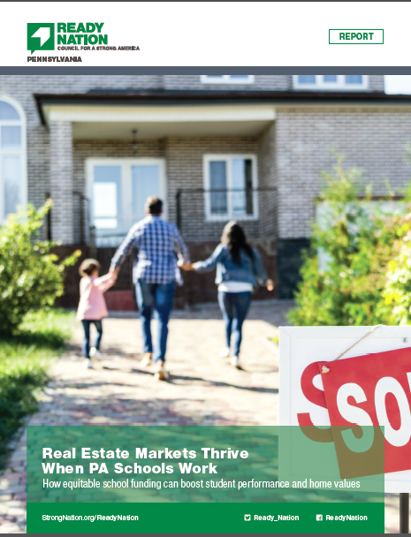
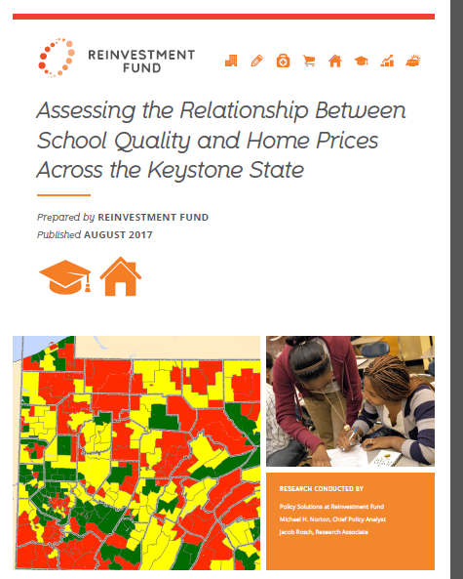
ReadyNation Report and Reinvestment Fund’s Source Report
Source/Technical Report: https://www.reinvestment.com/research-publications/assessing-relationship-school-quality-home-prices-across-keystone-state/
This work was supported with a grant from the William Penn Foundation.
Source/Summary Report: https://www.strongnation.org/articles/854-readynation-pa-realtors-bureau

Slide 4
Measuring the Relationship Between School Quality and Home Sales Prices
Our Question: “How does improving school quality affect home sales prices in a district?”
How do we measure home prices?
Change in average residential sales prices, 2010-11 to 2014-15
How do we measure school quality?
Performance on state standardized tests in reading and math in 2009-10 & 2010-11
What other factors do we account for?
Population change, 2010 to 2015
Unemployment change, 2010 to 2015
Median home sales price in 2010-11
Location of school district (rural, small town, suburb, urban)

Slide 5
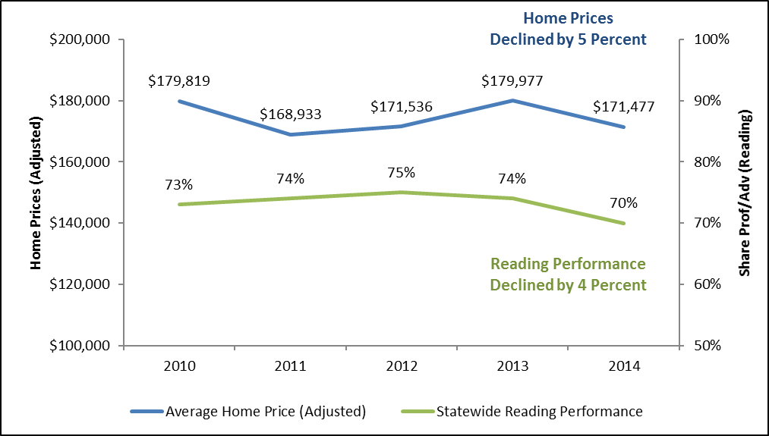
Statewide, Prices and Performance Follow Similar Trends
Change in Average Home Prices and Share of Students Scoring Proficient or Advanced in Reading, 2010 to 2014
Note: Home prices adjusted to 2014 dollars using the CPI

Slide 6
District Performance had a Strong, Positive, and Statistically Significant Relationship with Changes in Home Prices
A One Percentage Point Improvement in Student Proficiency was Associated with a Gain of $513 to $620 in Average Home Prices in Subsequent Years
 | Change in Home Prices from Increasing Proficiency by 1% | Change in Home Prices from Increasing Proficiency by 5%
Reading | $620.01 | $3,100.05
Mathematics | $513.25 | $2,566.24
A One Percentage Point Reduction in Students in the Lowest Performance Category was Associated with a Gain of $757 to $776 in Average Home Prices in Subsequent Years
 | Change on Home Prices of Reducing Below Basic Perf. by 1% | Change on Home Prices of Reducing Below Basic Perf. by 5%
Reading | $775.90 | $3,879.51
Mathematics | $756.65 | $3,783.27

Slide 7
Districts with Lower Home Sales Prices and School Performance Stand to Gain the Most From Improving Schools
Average Price and Performance in 2010-11, and Estimated Changes in Home Sales Prices if Proficiency Improved by 5 Percentage Points
 | Average Home Price, 2010-11 | Students Scoring Proficient or Advanced in Reading, 2010-11 | Average Change in Home Prices, 2010-11 - 2014-15 | Est. Change in Home Prices if Performance Improved 5% Points | Pct. Increase in Est. Home Prices if Performance Improved 5% Points
Districts with Lowest Prices | $62,015 | 68% | $3,232 | $7,002 | 117%
Districts with Low Prices | $100,404 | 73% | -$2,093 | -$200 | 90%
Districts with Moderate Prices | $146,311 | 76% | -$9,243 | -$5,490 | 41%
Districts with Highest Prices | $264,129 | 83% | -$15,066 | -$12,088 | 20%
PA Average | $143,296 | 75% | -$5,793 | -$2,693 | 54%
Largest Expected Gains from Improving Performance by 5 Percentage Points
Note: Home prices adjusted to 2014 dollars using the CPI

Slide 8
For a City, Returns to School Improvement can be Substantial
Estimated Gains in Property Tax and Transfer Tax Revenue For a Small City (~35,000 residents) Associated with Improving School Performance*
+$567,013 per year
+$340,208 per year
+$113,403 per year
+$0
*Assumes a property tax rate of 1.35% and a transfer tax rate of 1.23%

Slide 9
Summary of Key Findings
Home Prices and School Quality Have a Mutually Reinforcing Relationship
Home prices and academic performance followed similar trajectories between 2010-15.
The association between home prices and performance is statistically significant even after controlling for other factors.
Increasing the share of students performing at grade level was associated with a $513 to $620 gain in home prices.
Decreasing the share of students performing at the lowest levels was associated with a $757 to $776 gain in home prices.
Aggregated Across a Community, Financial Returns to Improving Schools can be Substantial
School improvements that boost home sales prices can have a meaningful impact on property and transfer tax revenues.
For a small community, moderate academic gains could produce $100k to $500k per year in new tax revenue associated with more valuable real estate.
The largest potential gains are to districts with lower sales prices and the lower student performance – but home prices in all districts can be bolstered by elevated school performance.

Slide 10
Contact Information
Ira Goldstein, President, Policy Solutions
Reinvestment Fund
Ira.Goldstein@reinvestment.com

Slide 11
Appendix

Slide 12
For a City, Returns to School Improvement can be Substantial
Estimated Property Tax Revenue Gain For Average Sized City, From Improving School Performance by Five Percentage Points
New Property Tax Revenue
=
Housing
Units
+
Property
Tax Rate
+
Contribution of Performance
+
Districtwide Academic Gains
$519,666
=
15,000*
+
1.35%
+
$513.25
+
5.0
Estimated Transfer Tax Revenue Gain For Average Sized City, From Improving School Performance by Five Percentage Points
New Transfer Tax Revenue
=
Annual Home Sales
+
Property
Tax Rate
+
Contribution of Performance
+
Districtwide Academic Gains
$47,347
=
1,500
+
1.23%
+
$513.25
+
5.0
*15,000 housing units equates to a population of ~35,000

